Slide 1
APT 1040A
Introduction to Web Design and Applications
  Lecture 10: XML
  Thuku Lawrence

Slide 2
objectives
  Understand the concept of EXtensible Markup Language
  To differentiate between XML and HTML
  Coding websites using XHTML

Slide 3
Presentation Outline
Part 1: The basics of creating an XML document
Part 2: Developing constraints for a well formed XML document
Part 3: XML and supplementary technologies

Slide 4
Part 1: Background for XML
An Extensible Markup Language (XML) document describes the structure of data
XML and HTML have a similar syntax … both derived from SGML
XML has no mechanism to specify the format for presenting data to the user
An XML document resides in its own file with an ‘.xml’ extension

Slide 5
The Difference Between XML and HTML
XML was designed to structure, transport and store data, with focus on what data is.
HTML was designed to display data, with focus on how data looks.

Slide 6
Example
<note>
    <to>Students</to>
    <from>Lecturer</from>
    <heading>Reminder</heading>
    <body> text message about the exam </body>
</note>

Slide 7
The Basic Rules
XML is case sensitive
All start tags must have end tags
Elements must be properly nested
XML declaration is the first statement
Every document must contain a root element
Attribute values must have quotation marks
Certain characters are reserved for parsing

Slide 8
Common XML Errors for Element Naming
Do not use white space when creating names for elements
Element names cannot begin with a digit, although names can contain digits
Only certain punctuation allowed – periods, colons, and hyphens

Slide 9
XML tags
The tags in the example above (like <to> and <from>) are not defined in any XML standard. These tags are "invented" by the author of the XML document.
NB: That is because the XML language has no predefined tags
The tags used in HTML (and the structure of HTML) are predefined. HTML documents can only use tags defined in the HTML standard (like <p>, <h1>, etc.).
XML allows the author to define his own tags and his own document structure.

Slide 10
XML Separates Data from HTML
f you need to display dynamic data in your HTML document, it will take a lot of work to edit the HTML each time the data changes.
With XML, data can be stored in separate XML files. This way you can concentrate on using HTML for layout and display, and be sure that changes in the underlying data will not require any changes to the HTML.

Slide 11
XML is Used to Create New Internet Languages
A lot of new Internet languages are created with XML.
  XHTML the latest version of HTML

Slide 12
An Example XML Document
<?xml version="1.0" encoding="ISO-8859-1"?>
<note>
<to>Students</to>
<from>Lecturer</from>
<heading>Reminder</heading>
<body>Don't forget to hand in your assignment by 27th of March! </body>
</note>
  the first line is XML declaration
    The first line is the XML declaration. It defines the XML version (1.0) and the encoding used (ISO-8859-1 = Latin-1/West European character set).
  The next line defines the root element of the document (<note>)
  The next 4 lines defines 4 children elements
  The last line defines the end of the root (</note>)

Slide 13
<bookstore>
<book category="COOKING">
    <title lang="en">Everyday Italian</title>
    <author>Giada De Laurentiis</author>
    <year>2005</year>
<price>30.00</price>
</book>
<book category="CHILDREN">
    <title lang="en">Harry Potter</title>
    <author>J K. Rowling</author>
    <year>2005</year>
    <price>29.99</price>
</book>
<book category="WEB">
    <title lang="en">Learning XML</title>
    <author>Erik T. Ray</author>
    <year>2003</year>
    <price>39.95</price>
</book>
</bookstore>

Slide 14
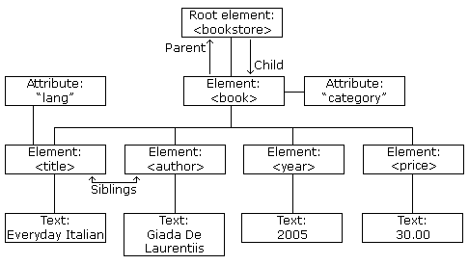

Slide 15
XML Tags are Case Sensitive
All XML documents must have a root elements
XML Tags are Case Sensitive
  <Message>This is incorrect</message>
  <message>This is correct</message>
Unlike HTML,
  All xml elements must have a closing tags
  All elements must be properly nested
  <root>
  <child>
  <subchild>....</subchild>
  </child>
  </root>

Slide 16
XML Attribute Values Must be Quoted
Wrong
      <note date=12/11/2007>
      <to> students</to>
      <from>Lecturer</from>
      </note>
Correct
      <note date="12/11/2007" >
      <to>Students</to>
      <from>Lecturer</from>
      </note>

Slide 17
XML elments vs attributes
<?xml version="1.0"?>
<note date=“27/02/2009”>
    <to>Students</to>
    <from>lecture</from>
</note>
<?xml version="1.0"?>
<note>
date> 27/02/2009 </date>
    <to>Students</to>
    <from>lecture</from>
</note>
They both say the same think. Better the avoid attributes

Slide 18
Why avoid Attributes
Attributes cannot contain multiple values (elements can)
Attributes cannot contain tree structures (elements can)
Attributes are not easily expandable (for future changes)
Attributes are difficult to read and maintain
    Bellow show how attributes are difficult to read
      <note day="10" month="01" year="2008" to="Tove" from="Jani" heading="Reminder" body="Don't forget me this weekend!“></note>
    Use elements for data
    Use attributes for information that is not relevant to the data

Slide 19
Well formed XML document
A "Well Formed" XML document has correct XML syntax.
XML syntax rules are
    XML documents must have a root element
    XML elements must have a closing tag
    XML tags are case sensitive
    XML elements must be properly nested
    XML attribute values must be quoted

Slide 20
Example of well formed XML document
<?xml version="1.0"?>
<note>
    <to>Students</to>
    <from>lecture</from>
    <heading>Reminder</heading>
    <body> The assignment submission is on 27/03/09</body>
</note>

Slide 21
Part 2: Legal Building Blocks of XML
A Document Type Definition (DTD) allows the developer to create a set of rules to specify legal content and place restrictions on an XML file
If the XML document does not follow the rules contained within the DTD, a parser generates an error
An XML document that conforms to the rules within a DTD is said to be valid

Slide 22
Valid XML document
A "Valid" XML document is a "Well Formed" XML document, which also conforms to the rules of a Document Type Definition (DTD)
The purpose of a DTD (Document Type Definition) is to define the legal building blocks of an XML document.
DTD defines the document structure with a list of legal elements and attributes.
DTD declaration in a valid XML document can defined in two ways
  Internally
  Externally

Slide 23
Why use DTD?
With a DTD, each of your XML files can carry a description of its own format.
With a DTD, independent groups of people can agree to use a standard DTD for interchanging data.
Your application can use a standard DTD to verify that the data you receive from the outside world is valid.
You can also use a DTD to verify your own data.

Slide 24
Why Use a DTD?
  A single DTD ensures a common format for each XML document that references it
  An application can use a standard DTD to verify that data that it receives from the outside world is valid
  A description of legal, valid data further contributes to the interoperability and efficiency of using XML

Slide 25
Some Example DTD Declarations
Example 1: The Empty Element
<!ELEMENT Bool (EMPTY)> <!--DTD declaration of empty element-->
<Bool Value="True"></Bool> <!--Usage with attribute in XML file-->
Example 2: Elements with Data
<!ELEMENT Month (#PCDATA)> <!--DTD declaration of an element->
<Month>April</Month> <!—Valid usage within XML file-->
<Month>This is a month</Month> <!—Valid usage within XML file-->
<Month> <!—Invalid usage within XML file, can’t have children!-->
<January>Jan</January>
<March>March</March>
</Month>

Slide 26
Some Example DTD Declarations
Example 3: Elements with Children
To specify that an element must have a single child element, include the element name within the parenthesis.
<!ELEMENT House (Address)> <!—A house has a single address-->
<House> <!—Valid usage within XML file-->
<Address>1345 Preston Ave Charlottesville Va 22903</Address>
</House>
An element can have multiple children. A DTD describes multiple children using a sequence, or a list of elements separated by commas. The XML file must contain one of each element in the specified order.
<!--DTD declaration of an element-->
<!ELEMENT address (person,street,city, zip)>
<!ELEMENT person (#PCDATA)>
<!ELEMENT street (#PCDATA)>
<!ELEMENT city (#PCDATA)>
<!ELEMENT zip (#PCDATA)>
<!—Valid usage within XML file-->
<address>
<person>John Doe</person>
<street>1234 Preston Ave.</street>
<city>Charlottesville, Va</city>
<zip>22903</zip>
</address>

Slide 27
Cautions concerning DTDs
All element declarations begin with <!ELEMENT and end with >
The ELEMENT declaration is case sensitive
The programmer must declare all elements within an XML file
Elements declared with the #PCDATA content model can not have children
When describing sequences, the XML document must contain exactly those elements in exactly that order.

Slide 28
DTD internal declaration
<?xml version="1.0"?>
<!DOCTYPE note [
    <!ELEMENT note (to,from,heading,body)>
    <!ELEMENT to (#PCDATA)>
    <!ELEMENT from (#PCDATA)>
    <!ELEMENT heading (#PCDATA)>
    <!ELEMENT body (#PCDATA)>
]>
<note>
    <to>Students</to>
    <from>lectures</from>
    <heading>Reminder</heading>
    <body> The assignment submission is on 27/03/09</body>
</note>

Slide 29
DTD interpretation
<!DOCTYPE note [
    <!ELEMENT note (to,from,heading,body)>
    <!ELEMENT to (#PCDATA)>
    <!ELEMENT from (#PCDATA)>
    <!ELEMENT heading (#PCDATA)>
    <!ELEMENT body (#PCDATA)>
]>
!DOCTYPE note defines that the root element of this document is note.
!ELEMENT note defines that the note element contains four elements: "to,from,heading,body".
!ELEMENT to defines the to element to be of the type "#PCDATA".
!ELEMENT from defines the from element to be of the type "#PCDATA".
!ELEMENT heading defines the heading element to be of the type "#PCDATA".
!ELEMENT body defines the body element to be of the type "#PCDATA".

Slide 30
External DTD Declaration
<!DOCTYPE note [
    <!ELEMENT note (to,from,heading,body)>
    <!ELEMENT to (#PCDATA)>
    <!ELEMENT from (#PCDATA)>
    <!ELEMENT heading (#PCDATA)>
    <!ELEMENT body (#PCDATA)>
]>
<?xml version="1.0"?>
<!DOCTYPE note SYSTEM "note.dtd" >
<note>
    <to>Students</to>
    <from>Lecture</from>
    <heading>Reminder</heading>
    <body> The assignment submission is on 27/03/09</body>
</note>
note.dtd

Slide 31
SGML and DTDs
SGML stands for “Standard Generalized Markup Language”
HTML, XHTML, XML and many other markup languages are defined in SGML
A DTD, or “Document Type Definition” describes the syntax to use for the current document
There are three different DTDs for XHTML--you can pick the one you want
    These DTDs are public and on the web
    You must start your XHTML document with a reference to one of these DTDs

Slide 32
DOCTYPE declaration, I
Every XHTML document must begin with one of the DOCTYPE declarations (DTDs):
  <!DOCTYPE html PUBLIC "-//W3C//DTD XHTML 1.0 Strict//EN" "http://www.w3.org/TR/xhtml1/DTD/xhtml1-strict.dtd">
  <!DOCTYPE html PUBLIC "-//W3C//DTD XHTML 1.0 Transitional//EN" "http://www.w3.org/TR/xhtml1/DTD/xhtml1-transitional.dtd">
  <!DOCTYPE html PUBLIC "-//W3C//DTD XHTML 1.0 Frameset//EN" "http://www.w3.org/TR/xhtml1/DTD/xhtml1-frameset.dtd">

Slide 33
DTD strict declaration
<!DOCTYPE html PUBLIC "-//W3C//DTD XHTML 1.0 Strict//EN" "http://www.w3.org/TR/xhtml1/DTD/xhtml1-strict.dtd">
    Use for really clean markup, with no display information (no font, color, or size information)
    Use with CSS (Cascading Style Sheets) if you want to define how the document should look

Slide 34
DTD Transitional declaration
<!DOCTYPE html PUBLIC "-//W3C//DTD XHTML 1.0 Transitional//EN" "http://www.w3.org/TR/xhtml1/DTD/xhtml1-transitional.dtd">
    Use with standard HTML and/or with CSS
    Allows deprecated HTML elements

Slide 35
DTD frameset declaration
  <!DOCTYPE html PUBLIC "-//W3C//DTD XHTML 1.0 Frameset//EN" "http://www.w3.org/TR/xhtml1/DTD/xhtml1-frameset.dtd">
    Use if your document uses HTML frames

Slide 36
Typical exam question
Explain the difference between a well formed XML document and a valid XML document.

Slide 37
Building blocks of an XML document
Elements
    <body>some text</body>
Attributes
    <img src=“image.gif" />
Entities
    &lt - <, &gt - >, &amp - &
PCDATA
    PCDATA means parsed character data.
    Think of character data as the text found between the start tag and the end tag of an XML element.
    In PCDATA text, the tags inside the text will be treated as markup and entities will be expanded
CDATA
    CDATA means character data.
    CDATA is text that will NOT be parsed by a parser. Tags inside the text will NOT be treated as markup and entities will not be expanded.

Slide 38
XML errors
      <?xml version="1.0"?>
      <note>
        <date> 27/02/2009 </date>
        <to> Students</to>
        <from> Lecturer
      </note>
<from> is not closed properly
Display this document on a browser will generate the following error:
      XML Parsing Error: mismatched tag. Expected: </from>.
      Location: http://www.doc.gold.ac.uk/~mas01lo/test.xml
      Line Number 7, Column 7:
      </note>
      ------^

Slide 39
Practice exercices
Write an xml document of your choice
Try to view it on a browser
If there is an error try to fix it and view it again

Slide 40
PART 3: XHTML

Slide 41
XHTML
http://www.w3schools.com/xhtml/

Slide 42
What is XHTML?
XHTML stands for EXtensible Hypertext Markup Language
    XHTML is aimed to replace HTML
    XHTML is almost identical to HTML 4.0
    XHTML is a stricter and cleaner version of HTML
XML (EXtensible Markup Language) is a markup
    XHTML is HTML redefined as an XML application
    XHTML is a “bridge” between HTML and XML
XHTML is W3C recommendation
    W3C (world wide web consortium)
    Creates and maintain the web standards
    For more information on W3C see the following link
      http://www.w3schools.com/w3c/

Slide 43
The problem with HTML
HTML started out as a way of way of describing the structure of documents, with tags to indicate headers, paragraphs, and the like
Because people wanted to control the appearance of documents, HTML acquired tags to control fonts, alignment, etc.
The result is a markup language that does both, but isn’t very good at either

Slide 44
Why XHTML?
Many pages contains “bad’’ html
All browser will display the following code
<html>
<head>
<title> This is bad HTML
</title>
<body>
<h1> Bad HTML
</body>

Slide 45
Why XHTML (cont’d)
Today's market consists of different browser technologies:
    some browsers run Internet on computers, and
    some browsers run Internet on mobile phones or other small devices.
    Small devices do not have the resources or power to interpret a "bad" markup language.
XML is a markup language where everything has to be marked up correctly, which results in "well-formed" documents.
XML was designed to describe data and HTML was designed to display data.
Therefore - by combining HTML and XML, and their strengths, we got a markup language that is useful now and in the future - XHTML.

Slide 46
HTML vs. XML
XML looks a lot like HTML, but--
HTML uses a fixed set of tags
With XML you make up your own tags (and define what they mean in a separate document)
HTML is designed to display data to humans
XML is designed to describe data to computers
Browsers are very tolerant of errors in HTML
XML documents must be well-formed (syntactically correct)
All browsers can display HTML
Most modern browsers can display XML

Slide 47
The Most Important Differences:
XHTML elements must be in lowercase
    <H1> text </h1> wrong
    <h1> text </h1> correct
XHTML elements must always be closed
    <i> text wrong
    <i> text </i> correct
    If an HTML tag is not a container, close it like this:
    <br />, <hr />, <image src="smile.gif" />
    Note: Some browsers require a space before the /
XHTML elements must be properly nested
    <b><i> This text is bold and italic </b></i> wrong
    <b><i> This text is bold and italic </i></b> correct
XHTML documents must have one root element

Slide 48
XHTML documents must have one root element
XHTML documents must be well-formed
      <html>
      <head> ... </head>
      <body> ... </body>
      </html>

Slide 49
From HTML to XHTML, II
Attribute names must also be in lower case
  Example: <table width="100%">
Attribute values must be quoted
  Example: <table width="100%">
Attribute minimization is forbidden
  Example: <frame noresize="noresize">,
  cannot be abbreviated to <frame noresize>
The id attribute replaces the name attribute
    Wrong: <img src="picture.gif" name="picture1" />
    Right: <img src="picture.gif" id="picture1" />
    Best: <img src="picture.gif" name="picture1" id="picture1" />

Slide 50
An XHTML Example
<!DOCTYPE html PUBLIC"-//W3C//DTD XHTML 1.0 Strict//EN" "http://www.w3.org/TR/xhtml1/DTD/xhtml1-strict.dtd">
<html >
<head>
<title>A simple document</title>
</head>
<body>
<p>A simple paragraph.</p>
</body>
</html>

Slide 51
Presenting XML: Extensible Stylesheet Language -- Transformations (XSLT)
Why Stylesheets?
    separation of content (XML) from presentation (XSLT)
Why not just CSS for XML?
    XSL is far more powerful:
      selecting elements
      transforming the XML tree
      content based display (result may depend on actual data values)
Notes:
separation => XML for apps/the machine, XSL to produce human readable output
selections: regular path expressions, select n-th child, string operations,
transformations: filter, reorder, restructure the tree (=query capabilities), e.g. TOC,
strip details, inline results of PIs, eg sorted table results of a query
content based: if value < 0 then red else black

Slide 52
XSL(T) Overview
XSL stylesheets are denoted in XML syntax
XSL components:
  1. a language for transforming XML documents (XSLT: integral part of the XSL specification)
  2. an XML formatting vocabulary (Formatting Objects: >90% of the formatting properties inherited from CSS)
Notes:
1. will be the focus
2. FOs denote typographic abstractions such as page, paragraph
finer level control (=properties):
word- and letter-spacing; and widow, orphan, and hyphenation control,

Slide 53
XSLT Processing Model
Transformation
XSLT stylesheet
XML source tree
XML,HTML,csv, text… result tree

Slide 54
Recursive Descent Processing with XSLT
take some XML file on books: books.xml
now prepare it with style: books.xsl
and enjoy the result: books.html
the recipe for cooking this was:
java com.icl.saxon.StyleSheet books.xml books.xsl > books.html
and now some different flavors: books2.xsl books3.xsl
Source: XSLT Programmer's Reference, Michael Kay, WROX

Slide 55
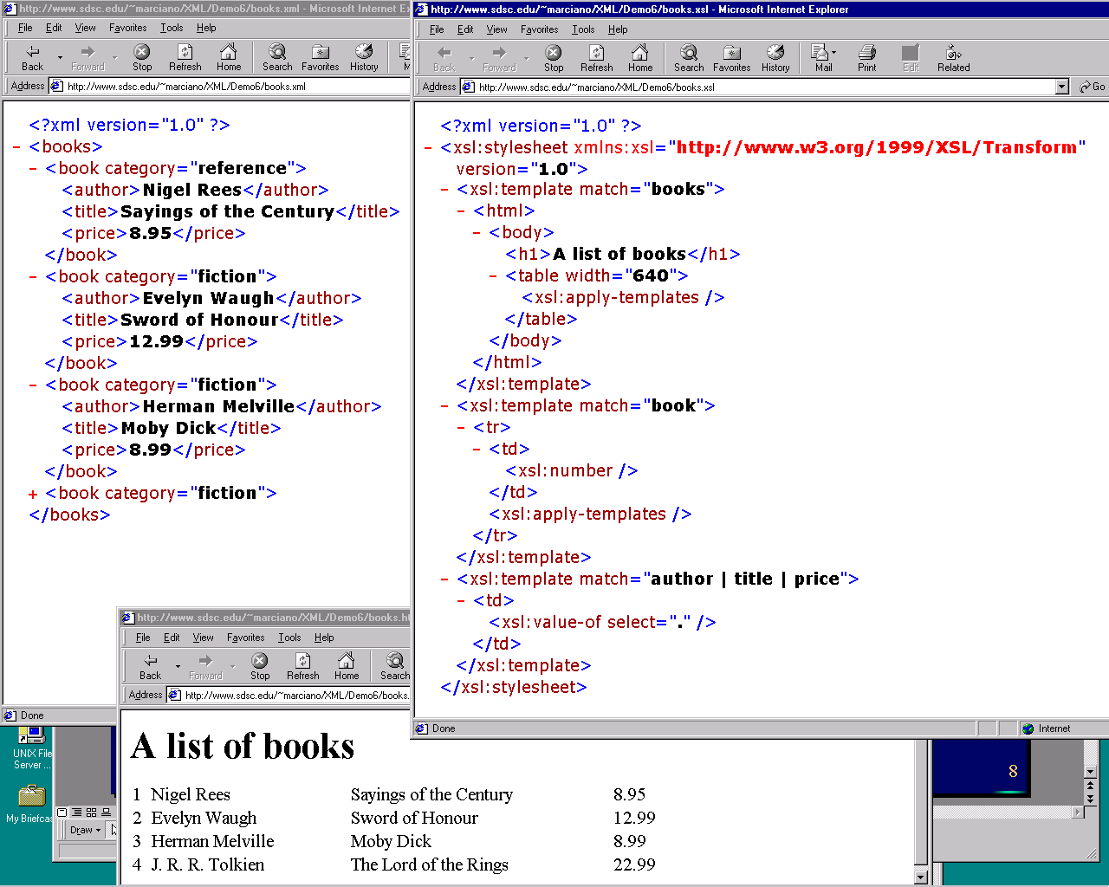
XSLT Example

Slide 56
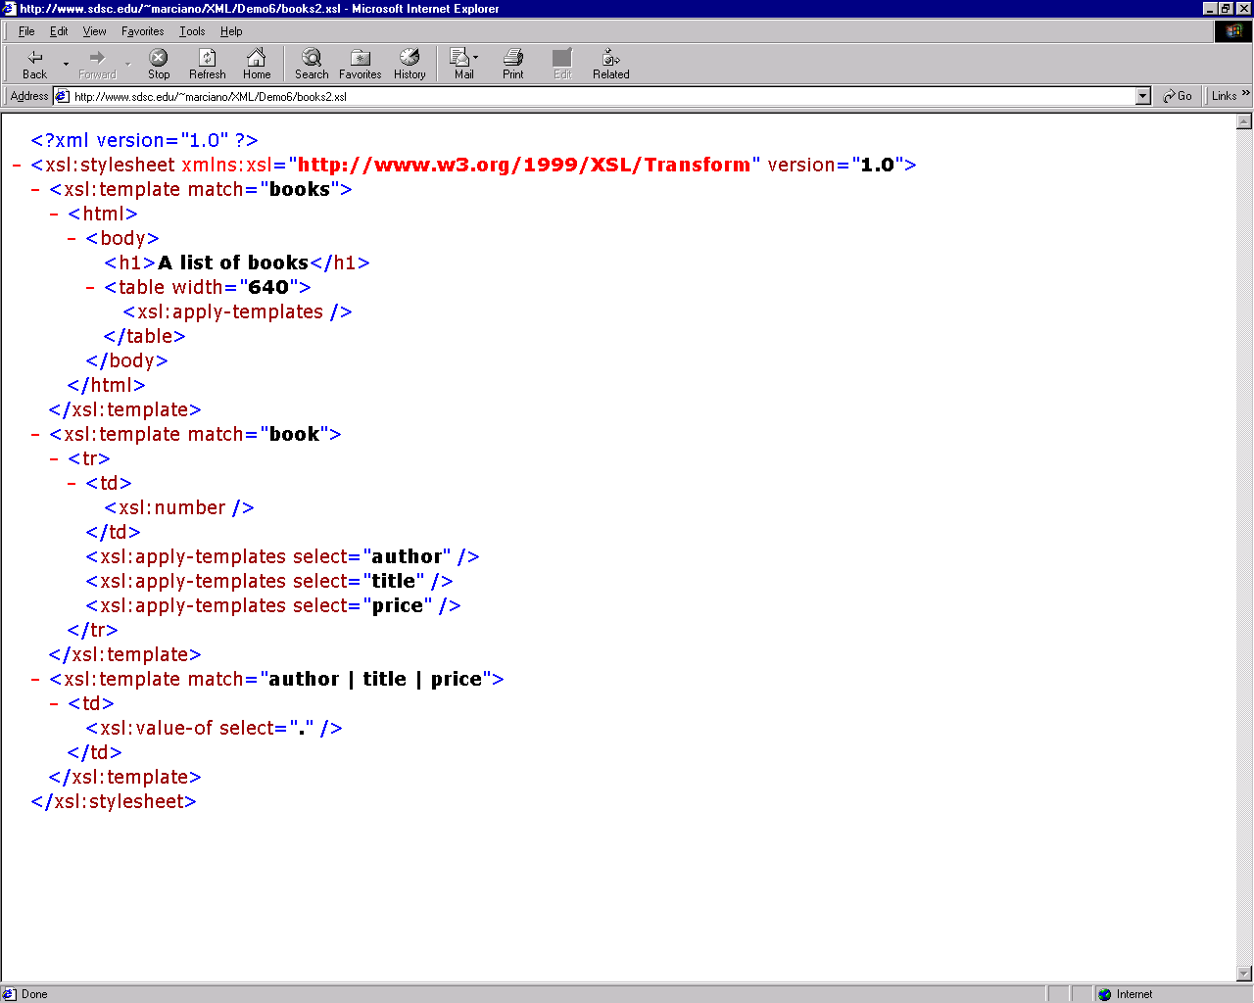
XSLT Example (cont’d)

Slide 57
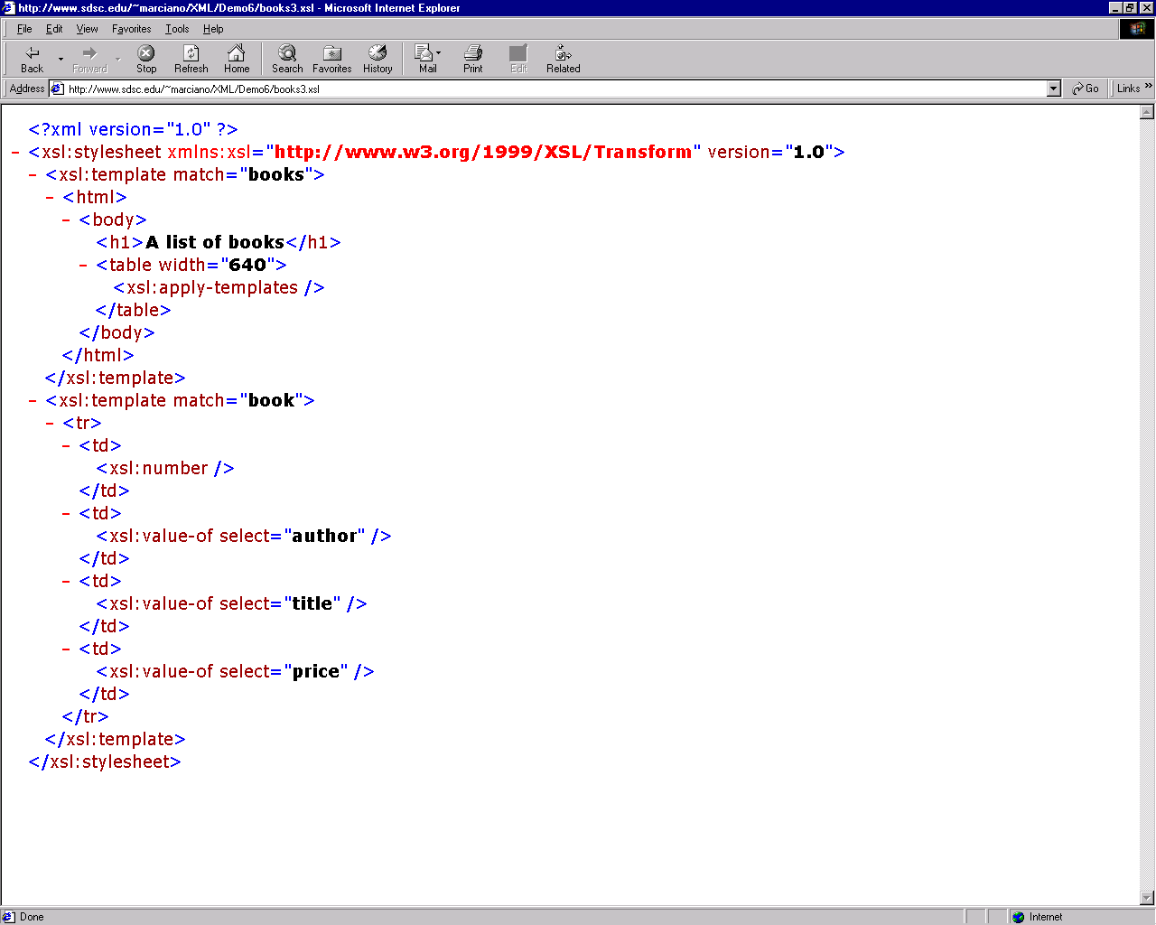
XSLT Example (cont’d)

Slide 58
Typical exam question
Question
  Explain the difference between html, xml and xhtml.
  Answer:
    XHTML is essentially a new version of HTML implemented as an XML application.
    XML itself is a general-purpose markup language which supports customised elements and attributes which can be defined via DTDs or XML Schema. XHTML is implemented using a series of DTDs.
    HTML’s syntax requires extensive error-correction in browsers and makes it very difficult to develop new applications for accessing web documents (“user agents”) since “documents claiming to be HTML are often so poor.”
    Coding web pages in XHTML rather than HTML will make it possible to include other XML applications such as MathML and will support XML tools such as XSLT for transforming or querying documents

Slide 59
Questions
What is meant by strict, transitional and frameset variants of HTML and XHTML? How can you indicate which of these you are using in a web document, and how can you verify that your document conforms to the relevant standard?
What are the shortcoming of HTML?
How does XHTML addresses these problems?
What is the difference between HTML and DHTML?
What are the steps required to convert and HTML code to XHTML?
What does it mean to say that html 1.0 is stateless?
what does it mean to say that an xml document is well formed?
What does it mean to say that an xml document is valid?

Slide 60
conclusion
CSS
  Inline style
  Embedded style or internal style
  External style
XML
  Gives a structure to data
    Root element
    Xml well formed vs valid
XHTML
  Stricter and cleaner than html, follows the xml strict syntax rules

Slide 61
Dynamic HTML
Everyone is a Web Designer.
  Learning DHTML, CSS and JavaScript is your next step into the web design world.
“DHTML” is a term used by some vendors to describe the combination of HTML, style sheets and scripts that allows documents to be animated.
Web pages can be made to respond to users’ actions.
Problem: How to achieve “Dynamic”?

Slide 62
What makes a web site dynamic?
Interactivity – adapt and react to the visitor’s actions as quick as possible.
Synchronicity – bring together relevant information from a variety of sources.
Flexibility – give the visitor different ways to find information in the site.
Adaptability – adjusts to cater to individual visitor’s needs.
Activity – uses motion and sound to draw user’s attention to changes on the site.

Slide 63
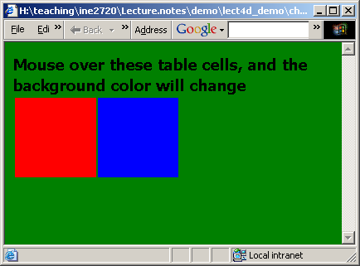
Change Background Color
<html><head>
<script language="JavaScript">
function bgChange(bg)
{ document.body.style.background=bg; }
</script></head>
<body><b>Mouse over these table cells, and the background color will change</b>
<table width="300" height="100">
<tr>
<td onmouseover="bgChange('red')"
onmouseout="bgChange('transparent')" bgcolor="red">
</td>
<td onmouseover="bgChange('blue')"
onmouseout="bgChange('transparent')" bgcolor="blue">
</td>
<td onmouseover="bgChange('green')"
onmouseout="bgChange('transparent')” bgcolor="green">
</td>
</tr>
</table>
</body></html>

Slide 64
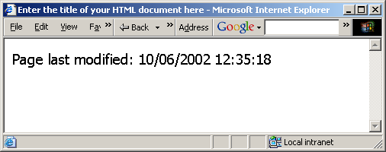
Adding last modified Date
<html>
<head>
<title>Enter the title of your HTML document here</title>
</head>
<body>
<script language=“JavaScript”>
document.write(“Page last modified: “ + document.lastModified)
</script>
</body>
</html>

Slide 65
Cool JavaScript Sites
http://www.dynamicdrive.com/
  Provides DHTML script examples
http://javascript.internet.com/
  JavaScript examples and get the source
http://www.js-examples.com/
  JavaScript examples
http://developer.netscape.com/docs/examples/javascript.html
  JavaScript examples from Netscape
http://www.jsworkshop.com/
  JavaScript Workshop
http://www.glassdog.com/
  An entertaining place for learning web design

Slide 66
JavaScript References
http://www.w3.org
  Resources of all standards
http://www.buildingtheWeb.com
  A well-structured website
http://www.htmlhelp.com
  HTML help by the web design group
http://www.webreview.com
  Includes coding, design tips, editorials
http://www.webreference.com
  In-depth articles on DHTML, CSS, …
http://www.faqts.com/knowledge_base/index.phtml/fid/53
  FAQs for DHTML, CSS, JavaScript, …

Slide 67
Other scripting languages used for dynamic webpages
PHP is a very popular scripting language for dynamic web pages creation.
ActionScript is used primarily for the development of websites and software using the Adobe Flash Player platform
Flash, ect,…

Slide 68
The End

